Slide 1


Government Relations & the Arts:
Structures & Strategies at Texas Tech University
ICFAD Panel: State Cultures & Best Practices
Tuesday, January 30th, 2024
Robin Phillips, Director of Development
J.T. & Margaret Talkington College of Visual & Performing Arts

Slide 2
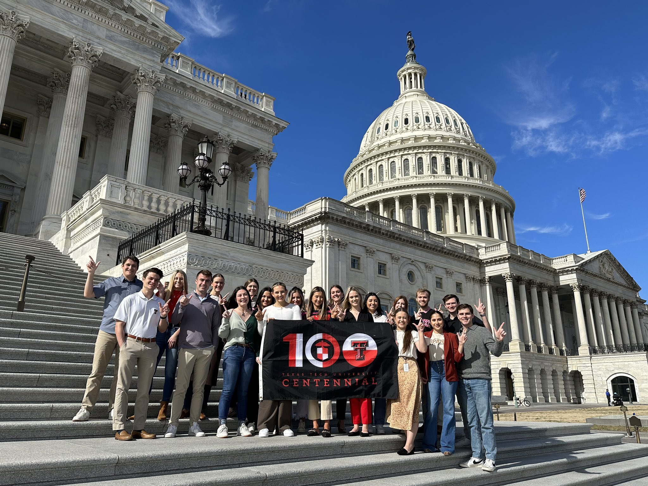
OVERVIEW
I. THE J.T. & MARGARET TALKINGTON COLLEGE OF VISUAL & PERFORMING ARTS: BACKGROUND
II. TEXAS TECH: GOVERNMENT RELATIONS, STRUCTURES, & FUNDING SOURCES
III. DEFINING LEGISLATIVE ENGAGEMENT
IV LEGISLATIVE CHANGES: MANAGING DONOR EXPECTATIONS

Slide 3
Vision Statement
The J.T. & Margaret Talkington College of Visual & Performing Arts (TCVPA) will be a distinguished global leader in interdisciplinary, creative, and scholarly arts education and research.
We will:
Champion the arts as relevant, critical, and essential to contemporary life.
Inspire our students to communicate through artistic tradition while embracing and creating innovative technologies as vehicles for individual expression and social change.
Pursue university, regional, national, and international partnerships that complement our programs and provide unique and contemporary opportunities for our students and faculty.
Engage in arts performance and research that will inform our teaching, scholarship and creative activity.
Take pride in the accomplishments of our faculty, students and alumni.

Slide 4


Department of
Interdisciplinary Arts
School of
Theatre & Dance
School of Music
School of Art

Slide 5

Our Values Culture

Slide 6



FAST FACTS
HOME TO OLDEST STUDENT ORG. ON CAMPUS
OVER $ 1 MILLION IN STUDENT SCHOLARSHIPS OFFERED EACH YEAR

Slide 7


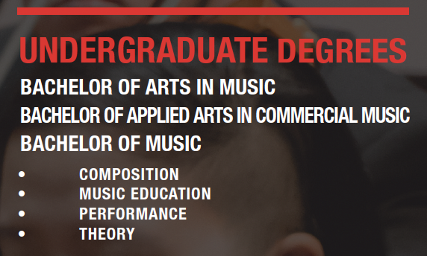
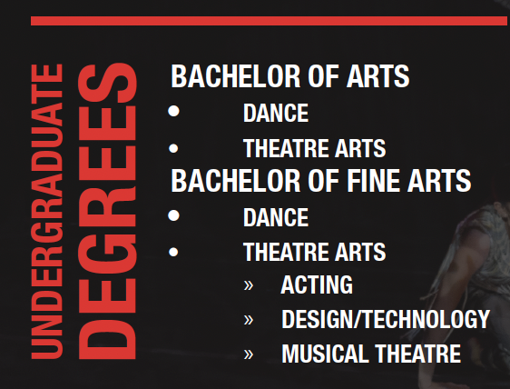
UNDERGRADUATE DEGREE PROGRAMS
SCHOOL OF ART
SCHOOL OF THEATRE & DANCE
SCHOOL OF MUSIC

Slide 8
GRADUATE DEGREE PROGRAMS
SCHOOL OF ART
12 Ph.D/M.F.A/M.A programs, with advanced degrees in all major artistic disciplines, including art education.
SCHOOL OF MUSIC
33 Ph.D/D.M.A./M.A programs across areas including individual instruments/voice, conducting, musicology, music theory, and music education.
SCHOOL OF THEATRE & DANCE
12 Ph.D/D.M.A./M.A programs including
acting/directing, dance studies, and design.
COLLEGE OF VISUAL & PERFORMING ARTS
Ph.D. Fine Arts Doctoral Program, certificates in
Arts Entrepreneurism

Slide 9
GOVERNMENT RELATIONS AT TTU:
STRUCTURE & PROCESS
Priorities set by executive leadership: President, Provost,
VP for Research, & CEO
Government Relations team: acts as liaison between the
Texas Tech System and elected officials at the federal and state levels

Slide 10
FUNDING CATEGORIES FOR
STATE OF TEXAS
PUBLIC UNIVERSITIES
Base formula funding: instruction, operations
-Comprises majority of funding-
Special, or non-formula, items: project-based
-limited, only a few per legislative session-
CCAP/Capital: funded sporadically

Slide 11
LEGISLATIVE ENGAGEMENT:
STRATEGIES FOR SUCCCESS
KEY QUESTION: In a university environment, how
do you define legislative engagement relative to the arts?
1. Focus on your “grassroots constituency”: students
2. Visible value: showcase the arts in your community
3. Prioritize internal relationship-building with
executive leadership

Slide 12
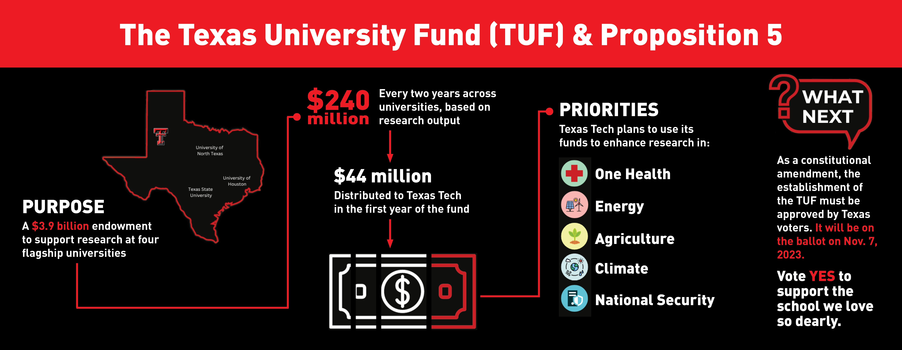
The TUF Fund: a Legislative Victory for TTU
Other 2023 session successes: 7% increase in formula funding, $50 million in
Institutional enhancement

Slide 13
ADAPTING TO LEGISLATIVE CHANGE:
MANAGING DONOR EXPECTATIONS
Example: TX SB 17 and scholarship criteria
Pre-SB 17 criteria: “Recipients should further the diversity, equity, and
inclusion initiatives of the J.T. & Margaret Talkington College
of Visual & Performing Arts.”
Post SB 17 criteria: “Recipients should fall into one or more of the following
categories: first generation, showing evidence of financial need as demonstrated
by the FAFSA, and/or membership in [various] registered student organizations.”

Slide 14
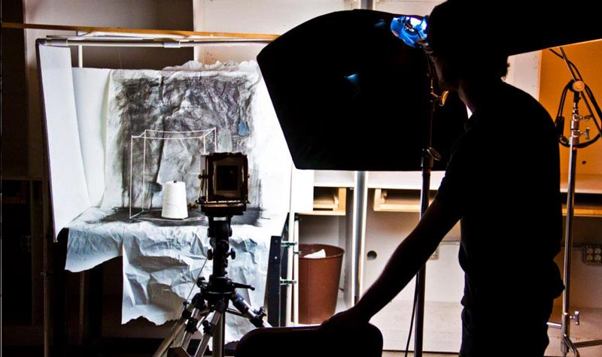


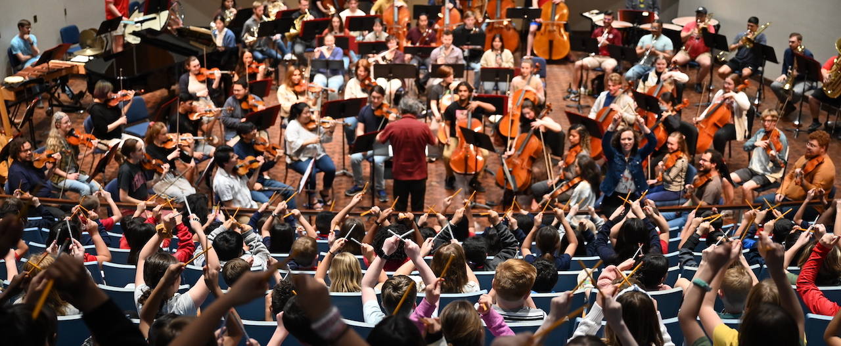
QUESTIONS?

