Slide 1
Fundraising Metrics: Measure With Care
James M. Langley
President , Langley Innovations
March 30, 2021

Slide 2
Fundraising Metrics
Principles
Measure we must
Coaching context
Don’t set the the bar so high only a lucky few can succeed
Don’t set the bar so low that no effort is required
Don’t set the bar and say, “Figure it out by yourself”
Don’t say, “If you don’t make the mark, you’re off the team.”
Do say, “Try, practice, learn.”
Do try to bring out the best in each person

Slide 3
Fundraising Metrics
Must be rooted in realism
New realities
Mature institutions
80 percent will come from current donors
80 percent of total giving will come from one percent of donors
New donor acquisition will be very tough

Slide 4
Fundraising Metrics
Need to measure movement, progress
Contacts?
Dollars?
Cultivation?
Phases of decision making
Anatomies of fundraising successes
7-9 interactions, 18 months or more

Slide 5
Fundraising Metrics
Current donors
Need objective criteria applied to prospects’ fundraising potential
Rank-ordered using predictive criteria
Giving potential based on highest gift not net worth
Equitable distribution across portfolios
Apples to apples

Slide 6
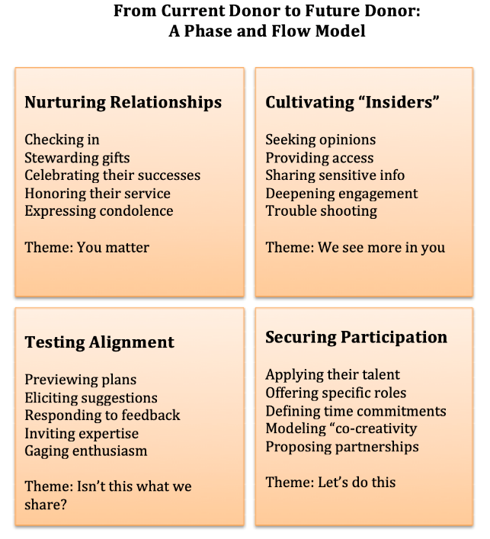

Slide 7
Fundraising Metrics
Phase and Flow
Allows you to measure movement
Determine in which phase each donor in a portfolio is, work with DO to encourage donors forward
Have to do more than “keep in touch” to lift donors’ sights

Slide 8
Fundraising Metrics
Fundraisers can’t do it all by themselves
Need more than vision
Where money will make significant, sustainable differences
Choices to offer donors that stand a good chance of resonating with their pre-existing convictions

Slide 9
Fundraising Metrics
New donor acquisition
Very tough to establish fair metrics
Objective prospect viability
Philanthropic patterns
Alignment with institutional strengths
Engaged by thought leader
Fundraiser as orchestrator
Arts have fewer major donor prospects

Slide 10
Fundraising Metrics
Fair metrics
Prospects determined objectively
Distributed equitably
Fundraisers coached and equipped
Monitor phase and flow
At least 80 percent current donors
Allow to tier portfolio to focus on those with strongest combination of propensity and capacity
New donor acquisition – team approach

Slide 11
Fundraising Metrics
Fair Metrics
Not imposed on fundraisers
Based on high but reasonable expectations
Derived from real donor behaviors – in your culture and similar cultures
A part of an experiment – to test, to try, to see what we learn, and to refine as we go
If metrics never change, what have we learned?

Slide 12
Fundraising Metrics
Photos by Peggy Killeen
Thank you
Questions

