Slide 1
Is Fundraising Keeping Up With Changing Philanthropic Behaviors?
James M. Langley
President , Langley Innovations
June 29, 2021

Slide 2
Changing Philanthropic Behaviors
The biggest change is in giving itself; fewer of us are doing it
The number of giving household in the U.S. has been in steady decline for decades
Percentage of Americans volunteering their time is down
Higher education has lost more donors than other sectors
Percentage of alumni giving annually has declined for 35 years, now less than one in ten ”give back”

Slide 3
Changing Philanthropic Behaviors
USA Higher Education
Individuals 79% 44% 26% Alumni
Foundations 16% 31%
Corporations 5% 15%
Other 10% Organizations

Slide 4
Changing Philanthropic Behaviors
Dollars UP
Donors Down

Slide 5
Changing Philanthropic Behaviors
Other changing behaviors
Decline in loyal giving and giving for institutional purposes
Unrestricted current
Unrestricted endowment
Especially at the higher levels of giving
Brick and mortar
Leveled off at 15% of total giving to higher education
Where campaigns encounter the most difficulty

Slide 6
Changing Philanthropic Behaviors
Other changing behaviors
Rise of the philanthropic investor
Giving through not just to
Significant sustainable impact
Designated to a particular area or discipline
Want to be involved early
Respond to content not gloss
HNW donors acting more like foundations
Guidelines
How will you measure and monitor effectiveness

Slide 7
Changing Philanthropic Behaviors
Targeted Investors
Case too long, vague
Undecided about giving
Diversity is a pre-req
Strengthen alignments
Questions sq. footage
Institutional Supporters
Like case for support
University is their top priority
Question DEI emphasis
Question planning time
Buys into space needs

Slide 8
Changing Philanthropic Behaviors
How fundraising should be changing
Obsess about donor retention, figure out why, stop talking about national averages
80% of fundraising effort on current donors
Compete for the attention of the 1% of donors who comprise 80% of total giving to HE
Stop trying to get people to give, start getting what the giving want to give to and why
Stop asking people to give to your school, start asking them to give through

Slide 9
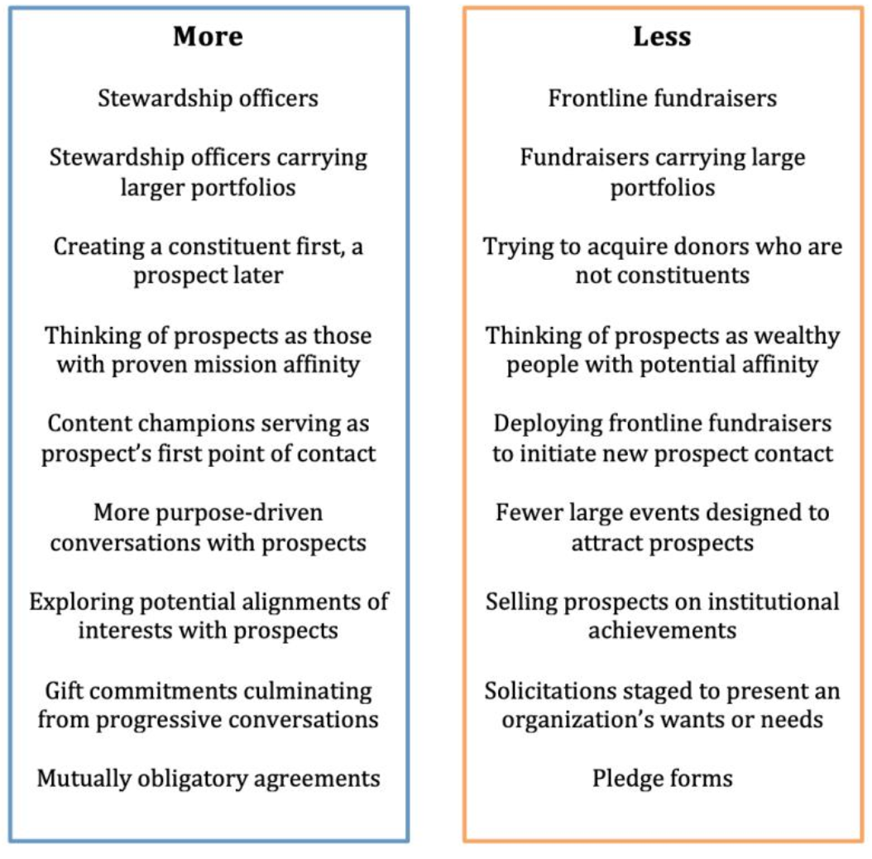

Slide 11
Changing Philanthropic Behaviors
Most important of all
Expend much more effort on creating the conditions for future fundraising success
Before fundraising was line of work, we the people collaborated to optimize our collective success, to imagine and cocreate better communities
The organizations we the people created became institutions, institutions ”professionalized” and minimized the role of the volunteer and the voice of the constituent
The bigger the organization, the bigger the headquarters and the more we talk to ourselves

Slide 12
Changing Philanthropic Behaviors
Creating the conditions for future fundraising success
Co-creation
Early-stage engagement
Review of drafts, plans
Preview material before meeting requests
White paper concepts – greater differences to be made

Slide 13
Changing Philanthropic Behaviors
Photo by Ian C. McLennan
Thank you
Questions

