Slide 1
Media Relations
The Great, The Good and the Challenges
Mary Dettloff, University of Massachusetts Amherst

Slide 2
A bit about me . . .
20+ years of experience in state government in Michigan working media relations in the state legislature, the Governor’s Office and a state department
Previous media relations director at Williams College
Current deputy news director at the University of Massachusetts Amherst

Slide 3
Challenges
The media landscape is ever-changing.
Print newspapers are modern-day dinosaurs and are shrinking
Newsrooms have shed half their employees since 2008
Social media is the dominant “news source” for 18-29 year olds
TV outpaces newspapers as the dominant source for the 50 and older crowd
At least half the U.S. has a low opinion of the media
                Source – Pew Research Center

Slide 4
Challenges
9 in 10 Americans get at least part of their news online
If you are under the age of 30, you are getting all your news online
6 in 10 Americans use their mobile device to read the news
TV is preferred over newspapers for sustained and breaking news coverage – Americans prefer to watch their news, rather than read it.
          Source – Pew Research Center

Slide 5
Some Good News
While they are relying more on online news, people still want a strong connection to their community news
Preferred news sources, though, continue to be TV and online news. Print newspapers lag behind

Slide 6
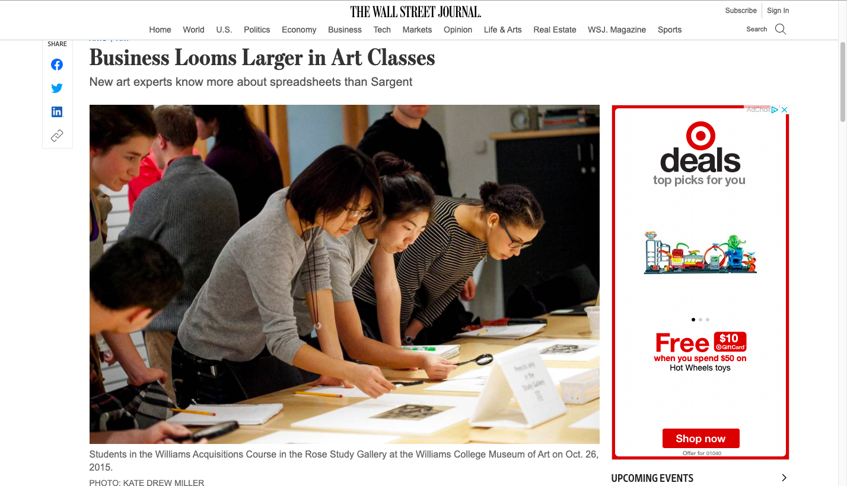
The best arts placement I have
Notes:
Ellen Gamerman was the reporter I worked with. I’m going to walk you through the process I used to get this story placed.

Slide 7
Have a Plan
I use the AMMO method – Audience, Message, Method/Medium, Outcome
What audience do I want to reach?
What is the main message (3-4 main points)?
What method or medium do I want to target (newspaper, radio, TV, blogger, all of the above)?
What is my desired outcome and what do I need to give this reporter to achieve it?
Notes:
Spoon-feeding reporters is tiresome, but necessary and it often works. Reporters are overworked and cannot specialize as much as they used to, except for larger markets like NYC, Washington, DC, Boston

Slide 8
Know the media
Read, watch or otherwise consume the media you want to target. What are they working on, what are they interested in?
Don’t overlook Black or Latinx media outlets. Same for LGBTQ+ media. Seek them out in your community.
Ask your faculty what they consume for media. In the fine arts and performing arts world, this is incredibly important because of all the specialty media there is out there for the arts, such as Hyperallergic.
Notes:
I go to the Black and Latinx owned businesses in my area and look for their news sources or ask the business owners if they advertise and where. What radio stations do they listen to? Are there specialty newspapers or other outlets for the community?

Slide 9
First, start local
Always be friendly, helpful and accessible to your local media
Get to know your media. Invite them to campus, set up some on- or off-the-record chats or visits with your key people
Offer them sneak peeks or advance stories of your new exhibits or productions
Build a relationship with key reporters in your area. It helps if something bad happens that you are talking to someone you already know rather than a complete stranger
Make sure they know you or your museum or arts faculty are experts or story resources for them. Keep a list of your experts and make it available to the media

Slide 10
Then, go national
National print outlets still have specialization among reporters, so they have higher ed or arts reporters.
Do your homework – make sure your faculty or administrator is willing to do media
Do your homework – target a reporter at an outlet. Don’t send the same pitch to several reporters
Do your homework – offer up images, the key research or important facts upfront in your pitch
Do your homework – check in with peer institutions or others to see if you can package a trend story for the reporter – it will increase your odds of a story getting reported
Notes:
Tell the story about the WSJ and the art-buying class

Slide 11
Gather the resources
Think about what you would need if you were a reporter:
  An expert or good source
  Background material
  Art – images, infographics, video
  Access
  Exclusive content

Slide 12
The pitch
Journalists receive dozens of pitches in a day and therefore only look at those that are relevant, newsworthy, brief, structured and timely. Here’s some tips:
Identify your target. Which reporter(s) do you want to pitch?
Build a relationship – follow them on Twitter or other social media, share their posts, comment on their stories
Personalize your pitch – demonstrate you regularly read them; clearly align your data, information, etc. with their interests; provide them the FACTS they need to make a decision; include your contact details
Have a great hook – give them new content they might not have seen before about the subject they write about; tie your story idea to recent stories they have done or the subject matter they cover
Follow up – don’t be surprised if you don’t get an immediate response. Studies show it sometimes takes 5 pitches to close the deal. Schedule a follow-up email for several days later if you don’t hear back. Keep trying because reporters are busy people often wearing many hats

Slide 13
Press releases – still relevant?
In short, yes.
But…

Slide 14
Press releases
Keep them short – a page and a half at the most – and full of FACTS. Remember, we are in the Age of Scrolling
Write for the media or audience, not for the “client”
Make sure they are about actual news – not promotional, not ego-stroking and not fluff
The average journalist is flooded with press releases and spends less than a minute reading each one
Releases are a quick, easy way to help a journalist – and that should be the focus
Releases are a way to start conversations with reporters
Highlight your faculty’s expertise in the release

Slide 15
Once they are hooked…
Be accommodating
Be welcoming
Be authentic
Guide as much as you can to proper sources and data/information
Don’t ask to see the story before it goes to press. That rarely happens, and never with a traditional outlet
Follow up with the reporter to make sure they got everything they need, offer resources (video, still images) and ask when they expect the piece to run

Slide 16
But . . . The New York Times
Some tips for NY Times placements
ALWAYS SET THE EXPECTATION (and set it low)
For news stories, read the archives of the reporters you want to connect with to see what they covered and if they tend to bundle or do trend stories.
For op-eds, consider a letter to the editor instead.
The NYT gets 1000s of op-ed (guest essays) submissions a day and it’s tough to break through. What they no longer receive many of is letters to the editor. Shorter, yes, but better odds of placement

Slide 17
Branch out
Consider other non-traditional outlets to tell your stories.
Podcasts
Bloggers
Social media stories (Instagram or Facebook stories, Instagram Reels, TikTok)
“Hyper-local” outlets – Patch, Substack, others by former journalists

Slide 18
Get in The Conversation
Become familiar with an online news site called The Conversation (https://theconversation.com/us).
General news stories written by faculty or researchers
Creative commons license allows republishing by any media outlet in the world
Great resource to showcase new research or tie expert to a current news issue
Has an Arts + Culture section
Contact Michelle McAdams (michelle.mcadams@theconversation.com) for a presentation or info session

Slide 19
Think on NBCNews.com
If you have faculty who want to write opinion pieces and can’t get them placed in the NY Times or elsewhere, try THINK on NBCNews.com
THINK has a lifestyle and culture section
To submit an essay or analysis to THINK, email THINK@nbcuni.com
Much like the NY Times, they get plenty of submissions, so make sure yours is timely and relevant. The more you can tie it to current affairs, the better

Slide 20
Questions?
Let’s talk
or
HMU at mdettloff@umass.edu

